Slide 1
Community detection in networks
Dafne van Kuppevelt
2018-05-31 Statistics SIG

Slide 2
Community detection in networks
Find groups of nodes that are relatively close to each other in the network
Why?
To understand meso-scale structure, cohesion/fragmentation, relationships between individual nodes
Image: Frank Takes

Slide 3
Different methods for community detection
Modularity
Generative models
Other models

Slide 4
Modularity
Intuition: More edges within-community edges than expected.
Optimize number of within-community edges compared to expected number of within-community edges.

Slide 5
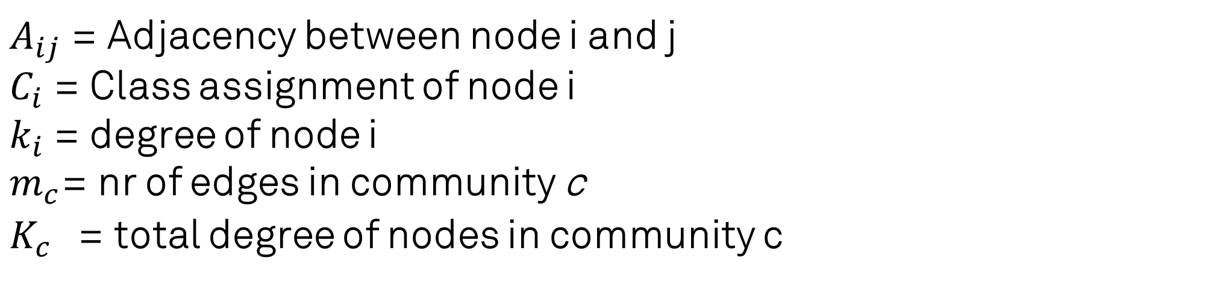
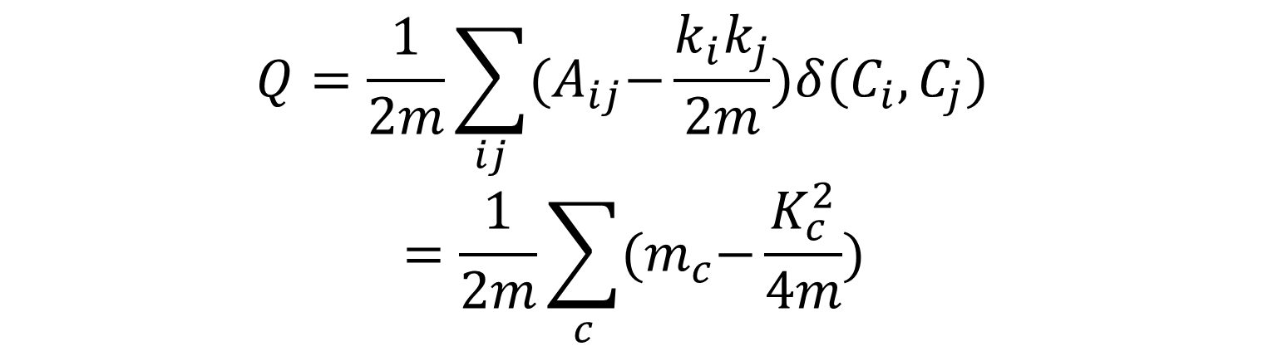
Modularity
Intuition: More edges within-community edges than expected.
Optimize number of within-community edges compared to expected number of within-community edges.
$$Q=\frac{1}{2m}\sum_{ij}{{(A}_{ij}−\frac{k_{i}k_{j}}{2m})δ(C_{i},C_{j})}$$
$$=\frac{1}{2m}\sum_{c}{{(m}_{c}−\frac{K_{c}^{2}}{4m})}$$
$A_{ij}$ = Adjacency between node i and j
$C_{i}$ = Class assignment of node i
$k_{i}$ = degree of node i
$m_{c}$= nr of edges in community c
$K_{c}^{}$ = total degree of nodes in community c

Slide 6
Modularity
Upside:
Fast approximate optimization (Louvain Method)
No fixed nr of communities
Downside:
Resolution limit: prefers communities of certain sizes
Exponential many near-optimal results
Optimization gives no significance

Slide 7
Generative Models
Intuition: there is a latent assignment in classes, and links between nodes are formed based on a distribution conditioned on the class assignment.

Slide 8
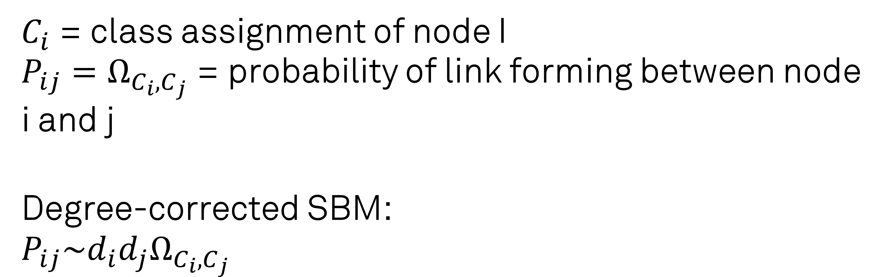
Stochastic Block Model
$C_{i}$= class assignment of node I
${P_{ij}=Ω}_{C_{i},C_{j}}$= probability of link forming between node i and j
Degree-corrected SBM:
$${P_{ij}\sim d_{i}d_{j}Ω}_{C_{i},C_{j}}$$

Slide 9
SBM Model inference
To find communities with the SBM model, infer parameters by maximizing likelihood.
Model selection is necessary to determine the number of communities.

Slide 10
Generative Models
Upside:
Explicit assumptions in model
Can give statistical significance
Can generate benchmark models
Downside:
Assumptions in model are not reflecting reality

Slide 11
Some other methods
Flow based models: Communities derived from behavior of random walks or flows on the network
Structural methods: k-cliques. Only applicable in certain domain
Similarity based methods: (hierarchical) clustering on structural similarity matrix

Slide 12
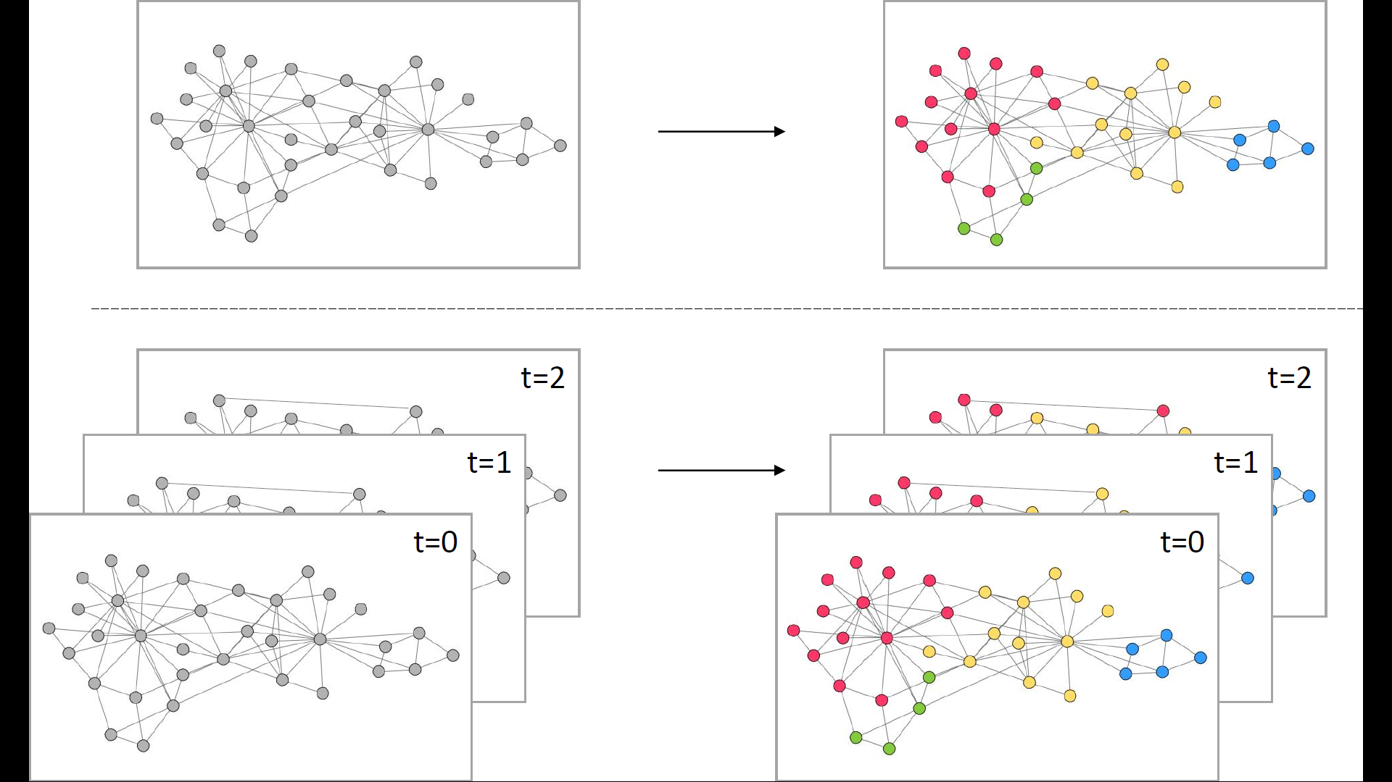
Time-evolving networks

Slide 13
Modularity extend to multiple time frames
Mucha et al. (2010): add coupling term to modularity function for intra-frame connections

Slide 14
Generative models for time-evolving networks
Many approaches based on Hidden Markov Model + Stochastic Block Model
Approaches based on processes for adding and removing links
Generative models for growing models (e.g. citation networks)

Slide 15
Extra challenges
Directed (acyclic graphs), such as citation networks
Weighted graphs
Nodes are not constant over time
Bimodal networks

Slide 16
References
[1] Rosvall, M., Delvenne, J.-C., Schaub, M. T. and Lambiotte, R. (2017) ‘Different approaches to community detection’, in. Available at: https://arxiv.org/pdf/1712.06468.pdf (Accessed: 12 April 2018).
[2] Fortunato, S. and Hric, D. (2016) ‘Community detection in networks: A user guide’, Physics Reports, 659, pp. 1–44. doi: 10.1016/j.physrep.2016.09.002.
[3] Good, B. H., de Montjoye, Y.-A. and Clauset, A. (2010) ‘Performance of modularity maximization in practical contexts’, Physical Review E, 81(4), p. 046106. doi: 10.1103/PhysRevE.81.046106.
[4] Mucha, P. J., Richardson, T., Macon, K., Porter, M. A. and Onnela, J.-P. (2010) ‘Community Structure in Time-Dependent, Multiscale, and Multiplex Networks’, Science, 328(5980), pp. 876–878. doi: 10.1126/science.1184819.
[5] Coscia, M., Giannotti, F. and Pedreschi, D. (2011) ‘A classification for community discovery methods in complex networks’, Statistical Analysis and Data Mining, 4(5), pp. 512–546. doi: 10.1002/sam.10133.

